Slide 1
Employment, Independence, and Equality DOR GENERAL SERVICES

Slide 2
ON A MISSION The California Department of Rehabilitation (DOR) works in partnership with consumers and other stakeholders to provide services and advocacy in pursuit of employment, independent living and equality for Californians with disabilities.

Slide 3
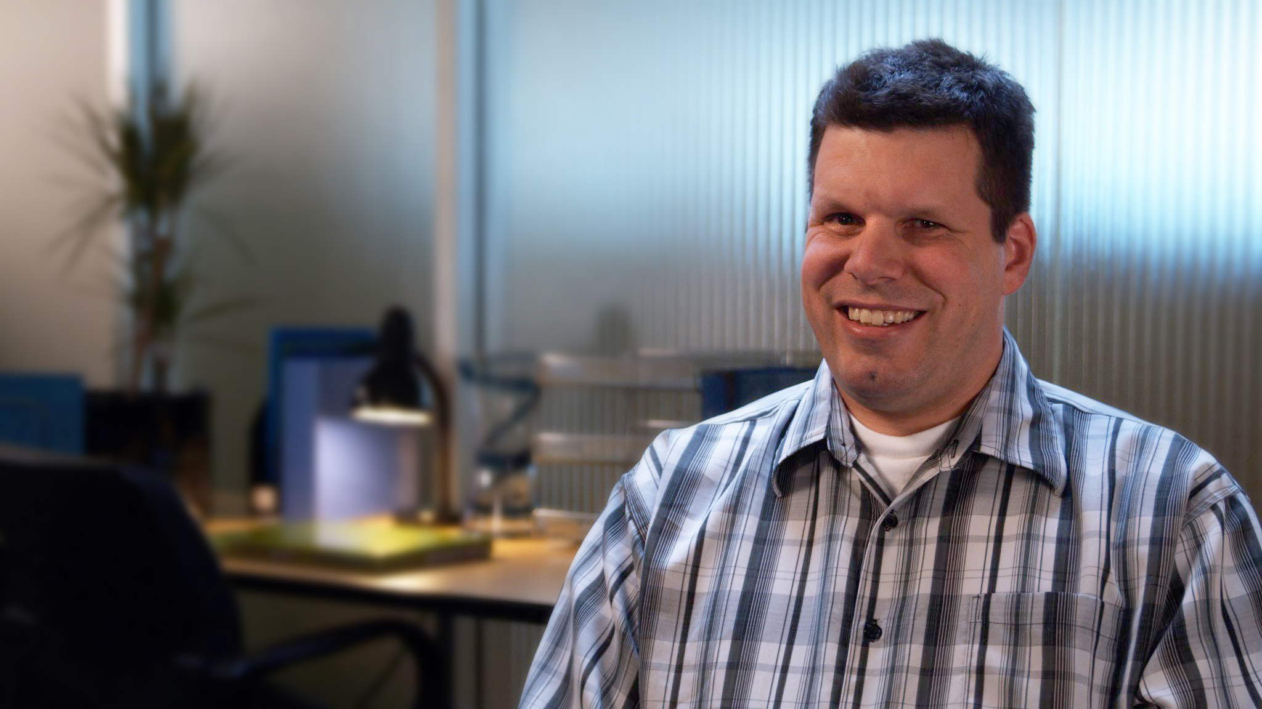
At DOR, it is our fundamental belief that individuals with disabilities can be fully integrated and highly productive community members, employees and colleagues.

Slide 4
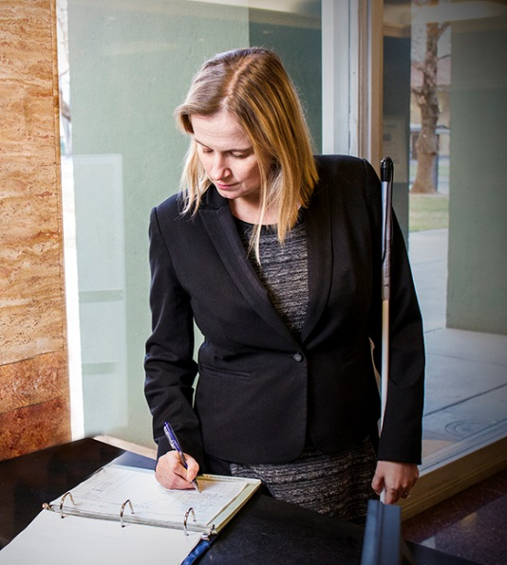
ELIGIBILITY To be eligible for services, an individual must:
Have a physical or mental impairment
Require vocational rehabilitation services to prepare for, secure, retain, or regain employment
Notes:
Have a physical or mental impairment that substantially impedes his or her ability to secure employment
Require vocational rehabilitation services to prepare for, secure, retain, or regain employment consistent with the applicant’s unique strengths, resources, priorities, concerns, abilities, capabilities, interests, and informed choice

Slide 5
Program participants are expected to be available, responsible, active and dedicated contributors to their own success.

Slide 6
Be Employed
HAVE A HIGHER QUALITY OF LIFE
Be Independent
Be Equal
Notes:
Be Employed: with training and support, an individual with a disability can access new opportunities..
Be Independent: with a dedicated sense of personal commitment, anyone with a disability can attain a level of independence that not only increases their self worth but also minimizes the strain on taxpayer funded financial support.
Be Equal: a disability is not a limitation. All people with disabilities have the right to work, perform and contribute to society.

Slide 7
CUSTOMIZED SERVICE DELIVERY We tailor our services to each person individually to ensure a greater chance for success.
Notes:
We tailor our services to each person individually to ensure a greater chance for success. A vocational rehabilitation team works closely with each job seeker to establish the best combination of services and resources necessary to prepare for, find, and retain employment.

Slide 8
Benefits Planning
Career assessment and counseling
Job search and interview skills
Independent living skills
Career education and training
Assistive technology
SERVICES
To apply for services contact a local DOR office: http://www.dor.ca.gov/DOR-Locations/
Notes:
Benefits Planning
Career assessment and counseling
Job search and interview skills
Independent living skills
Career education and training
Assistive technology

Slide 9
HIRING PEOPLE WITH DISABILITIES Businesses can benefit from programs that encourage the recruitment and hiring of people with disabilities. Employees with disabilities bring unique experiences. Several incentives are available, including tax incentives.
Notes:
Businesses can benefit from programs that encourage the recruitment and hiring of people with disabilities. Hiring an individual with a disability is an opportunity. Employees with disabilities bring unique experiences and understanding that can transform workplaces, products, and services. Several incentives are available, including tax incentives in the form of the Work Opportunity Tax Credit (WOTC) and On the Job Training (OJT) Incentives can help cover the cost of accommodations for employees with disabilities.

Slide 10
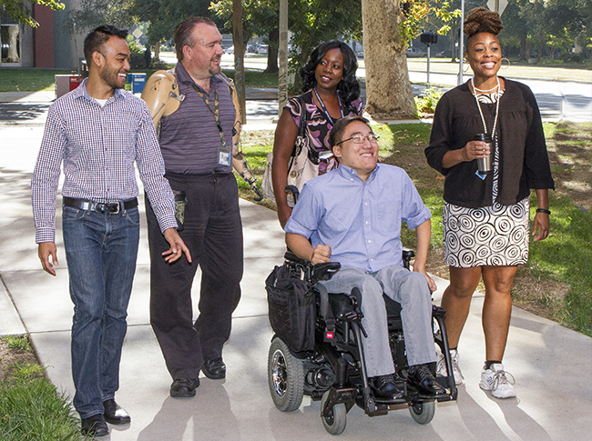
By hiring people with disabilities, employers are the key to DOR’s mission.
DOR provides education and information to businesses, and can help with integration when needed.
We believe in the talent and potential of individuals with disabilities.
Notes:
By hiring people with disabilities, employers are the key to DOR’s mission.
DOR provides education and information to businesses, and can help with integration when needed.
We believe in the talent and potential of individuals with disabilities.

Slide 11
For more information please contact:
California Department of Rehabilitation

